Slide 1

ValidusAnalytics
Internship

Slide 2
Week 1
Machine Learning
Theoretical Learnings
Data Mining
Artificial Intelligence
Neural Network
My Learnings
Image Classification
Practical Learnings
Audio Detection
Object Detection

Slide 3
Contents
Theoretical Learnings
Machine Learning
Practical Learning
Edge Impulse
ml5.js

Slide 4
Theoretical Learning
1
Let machines also learn
Modalities of the data
Pretrained Models
LLM

Slide 5
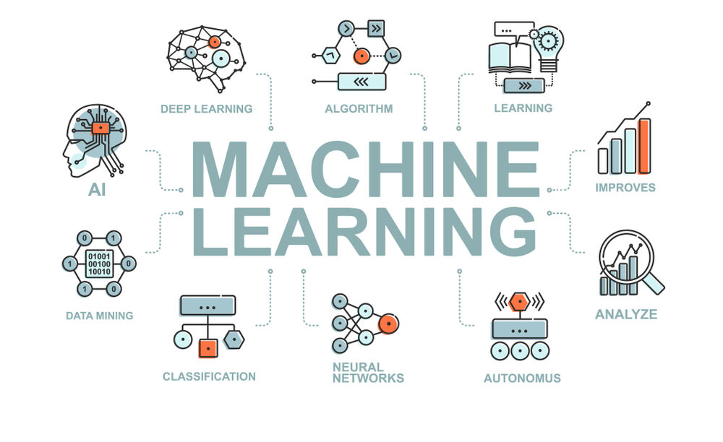
Let Machines also Learn
“Field of study that gives computers the ability to learn without being explicitly programmed ”
- Arthur Samuels

Slide 6
Modalities of Data
Numeric Data
Alphabetic / Textual Data
Images
Audio
In how many modes does the data can exists …..

Slide 7
Model Training and LLM
Initial Machine
Training of machine by providing Data
Pretrained Model

Slide 8
Practical Learning
2
ml5.js
Edge Impulse

Slide 9
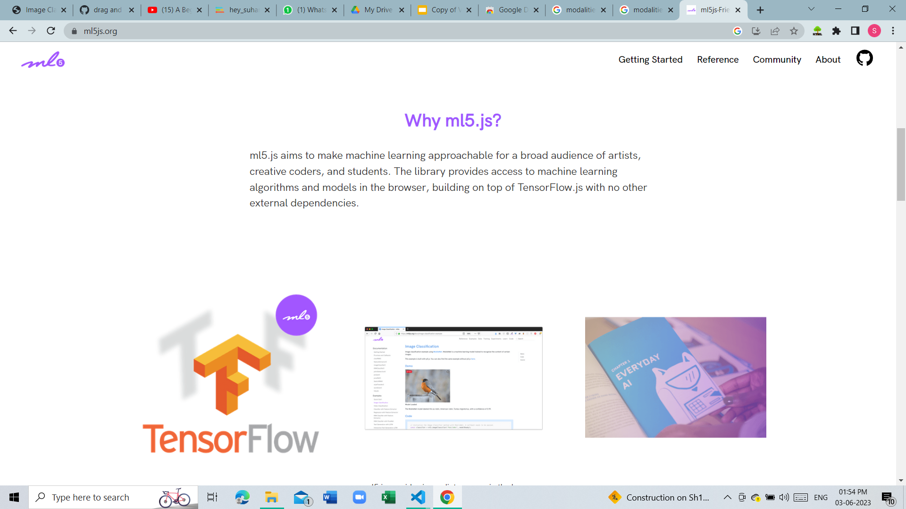
ml5.js
ml5.js ……………..
Wrapper around tf.js

Slide 10
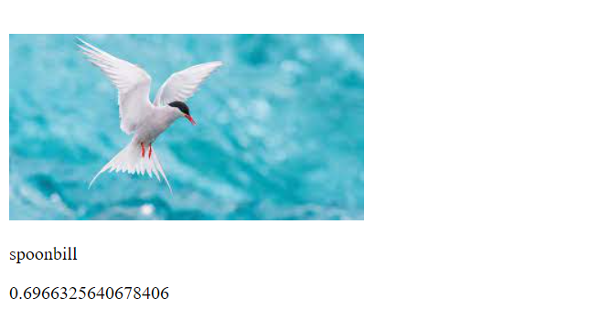
Image Classification
Image Classification done using ml5.js and p5.js
And by importing Mobile net
Name of the Bird
Confidence of the machine about its prediction

Slide 11
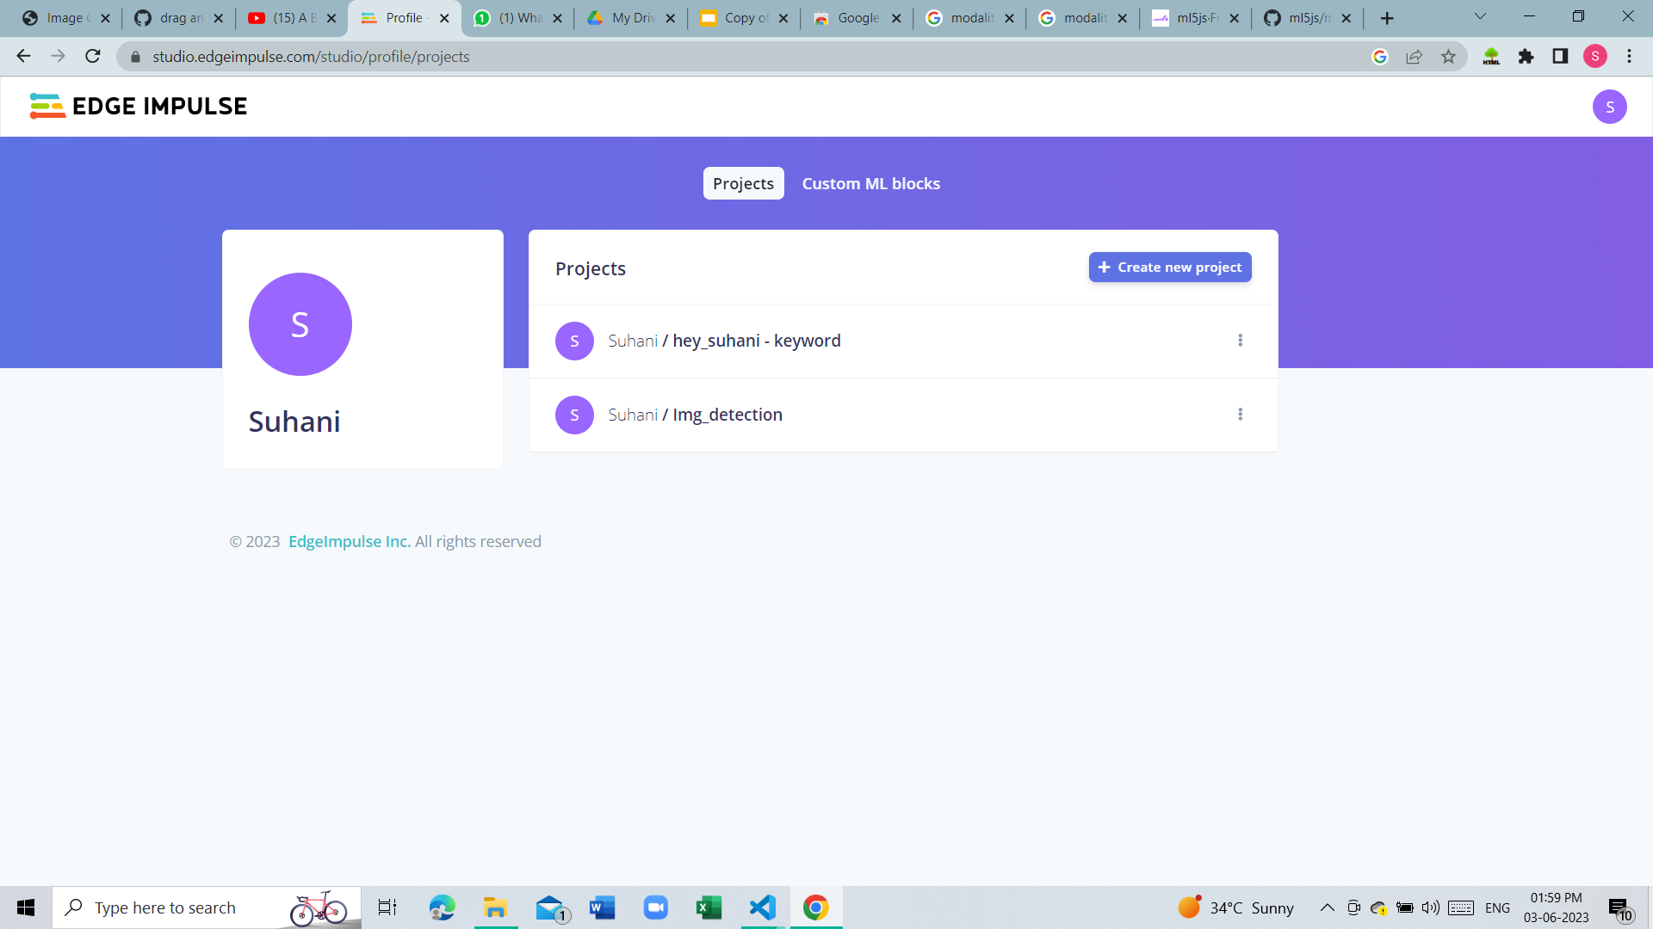
Edge Impulse
Open source platform
Web based application
Pretrained model
Train one your own data

Slide 12
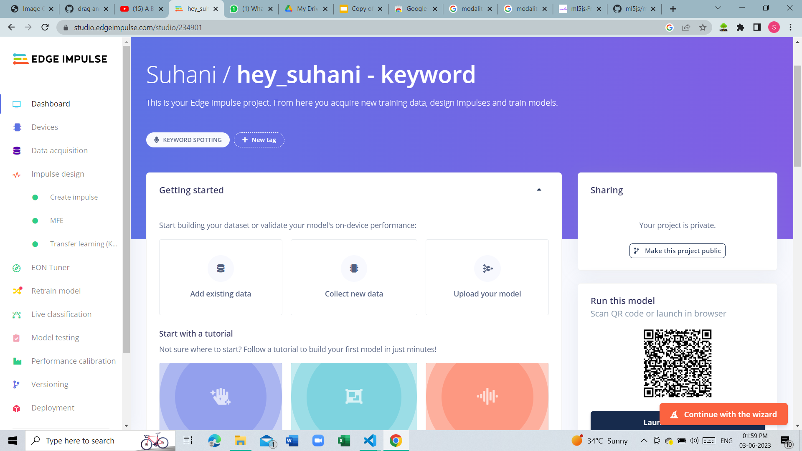
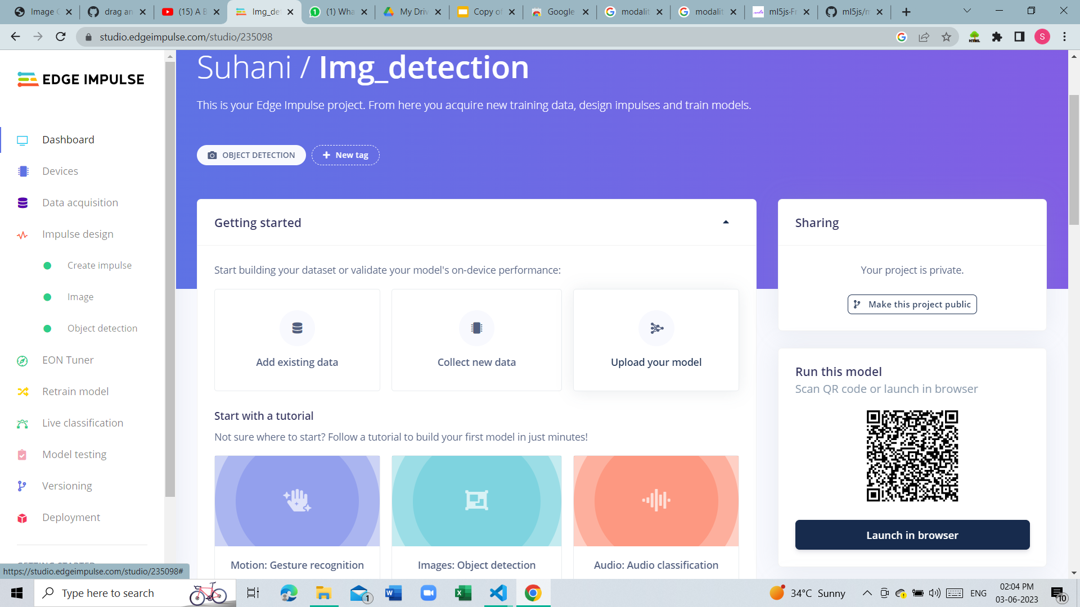
Detection of ….
Audio
Object

Slide 13
Thank You !
You can find me at suhanikolhatkar2005@gmail.com

